Slide 1
Polio Eradication Update and The Polio End Game KACHCON - 2015
Dr BP Subramanya
SMO, Bengaluru
WHO-NPSP

Slide 2
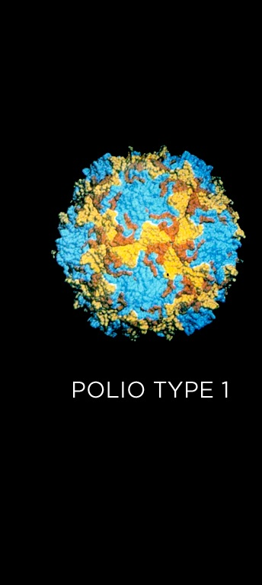
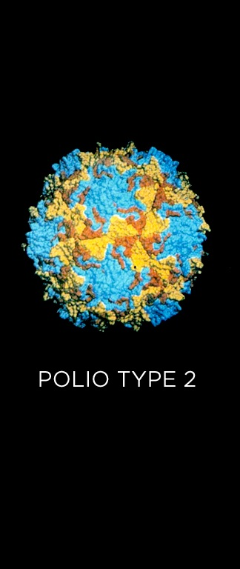
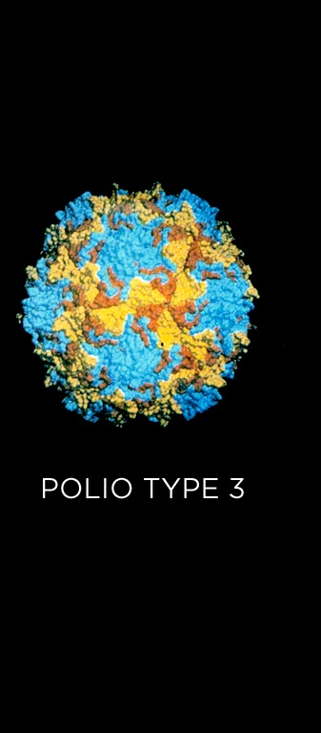
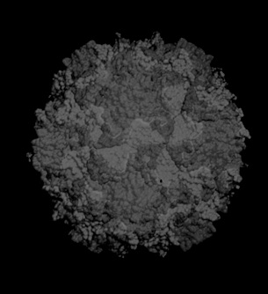
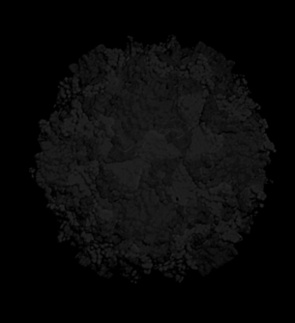
Not detected since Nov 2012

Slide 3
Wild Poliovirus Eradication, 1988-2012
125 Polio Endemic countries
to
3 endemic countries
125 Polio Endemic countries
2012
1988
Last type 2 polio in the world
Last Polio Case in India
Notes:
3

Slide 4
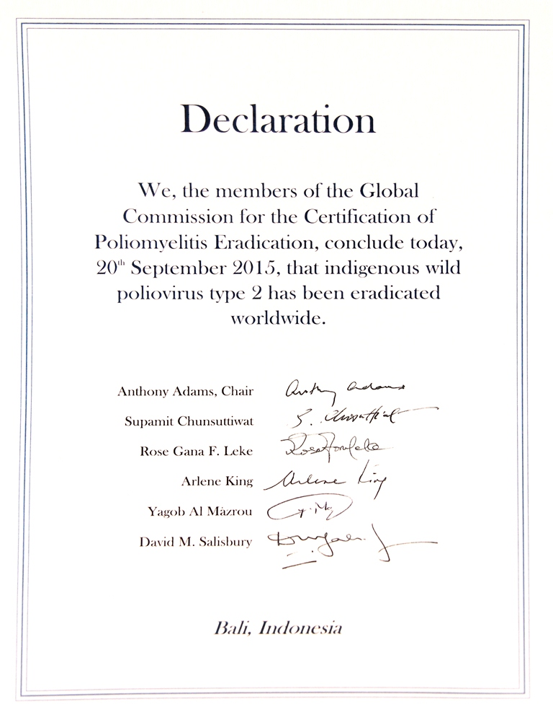

Slide 5
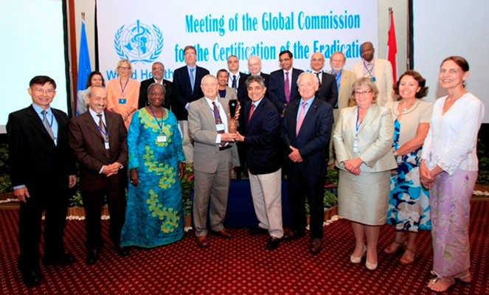
Global eradication of wild poliovirus type 2 declared
Declaration further milestone for globally-coordinated vaccine switch in 2016

Slide 6
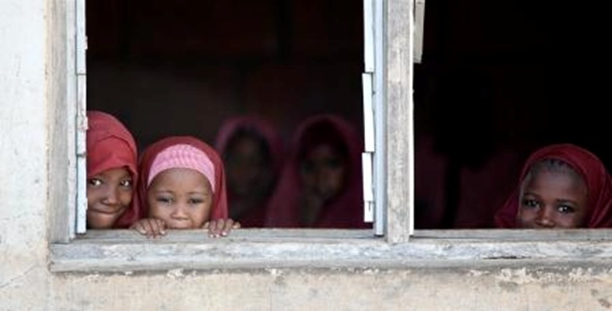
Friday, September 25, 2015
WHO Removes Nigeria from Polio Endemic List !!

Slide 7
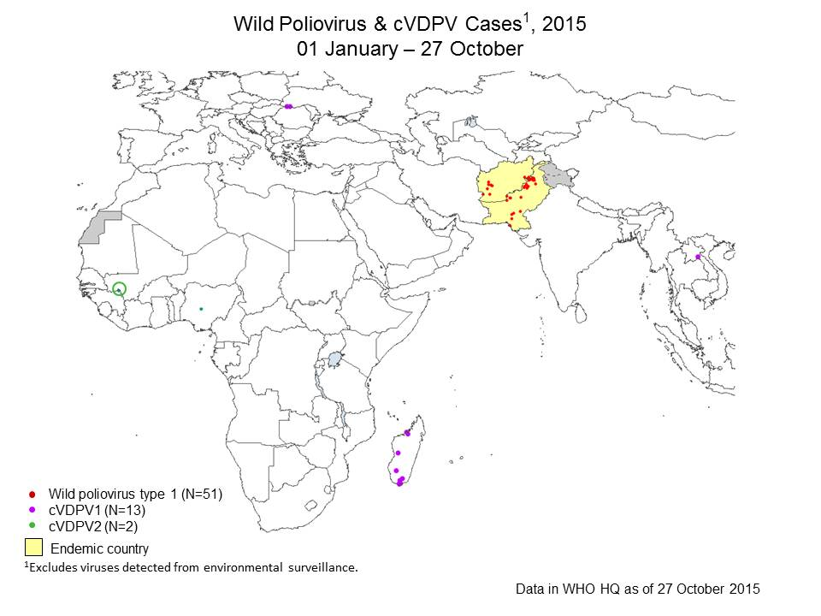

Slide 8
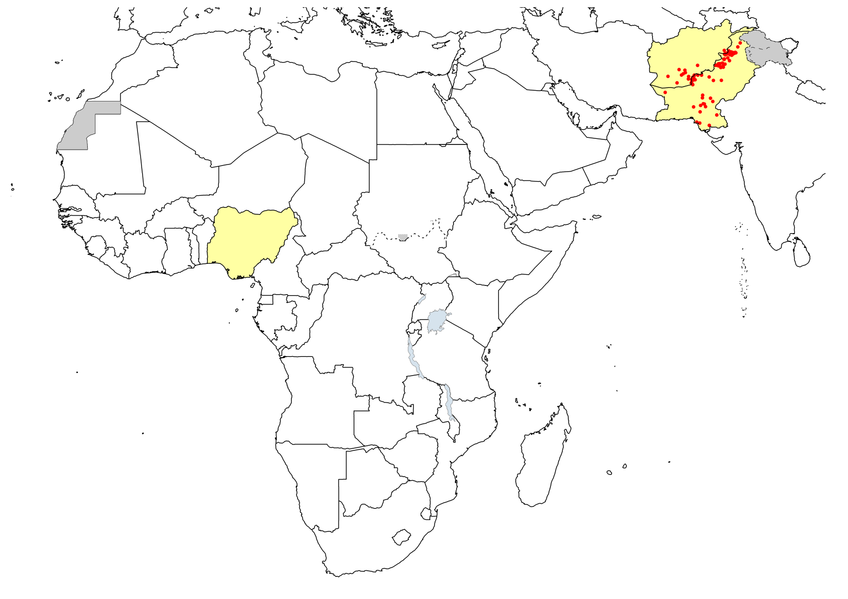
Wild Poliovirus Cases in 2014-15
Last Case Iraq, 7 April, 2014
Syria: 21 Jan, 2014
Israel (Env.): 30 March, 2014
Last Case Nigeria, 24 Jul, 2014
Last Case Cameroon, 9 Jul, 2014
Equatorial Guinea: 3 May, 2014
Last Case Somalia, 11 Aug, 2014
Ethiopia: 5 Jan, 2014
No WPV Reported in Africa or Middle East

Slide 9
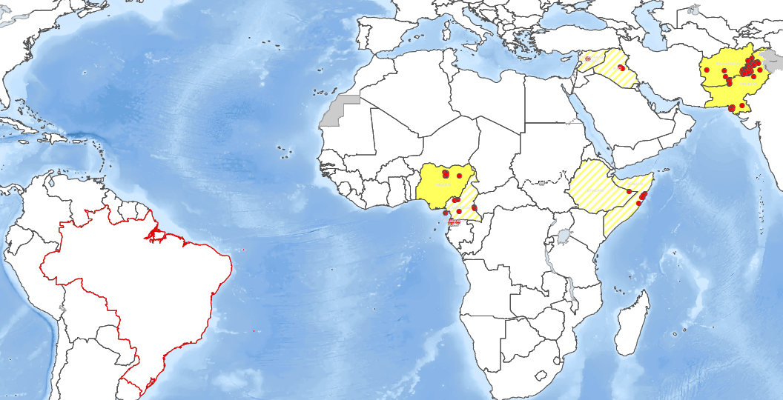
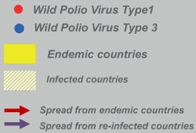
International exportation of poliovirus in 2014
But the Risk Remains……
International Spread of Polio, 2014
February
January
April
June
August
September
October
March
March
Iraq, Eq. Guinea
PAK to AFG

Slide 10
Situation of polio eradication in India

Slide 11
Polio free status maintained for >4 years
1934
1600
P1 wild
P2 wild
P3 wild
* data as on 18 July 2015

Slide 12
Environmental surveillance confirms no WPV since January 2011 in the country
Wild poliovirus type 1
Negative for wild poliovirus
Scheduled but sample not collected
X
Wild poliovirus type 3
Result pending
Sampling not scheduled

Slide 13
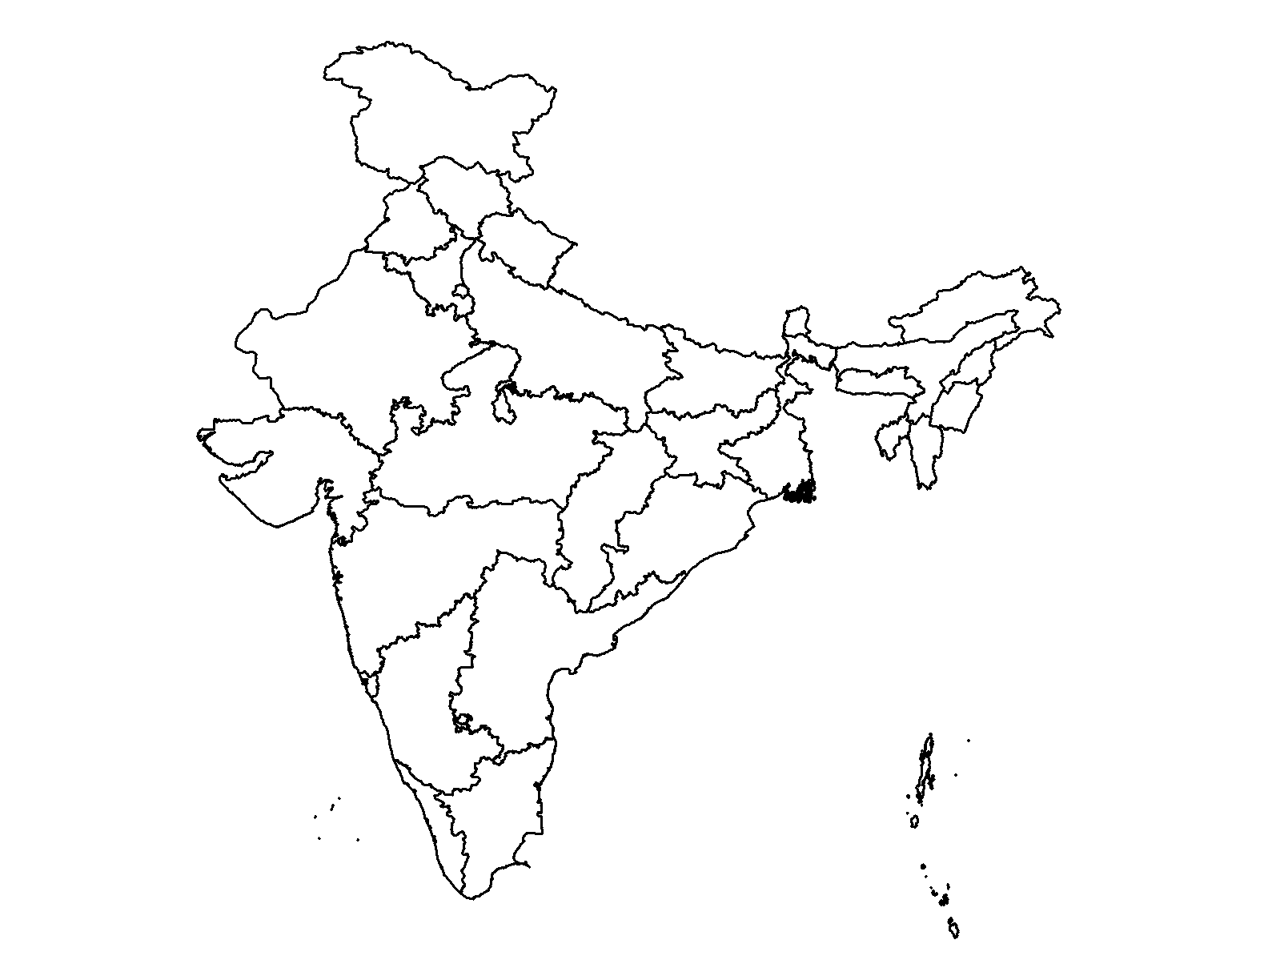
Major developments, India
Feb 2012:
WHO removes India from the list of polio endemic countries
Jan 2014:
India marks the third anniversary of the last polio case
WPV2
24/10/1999
Aligarh (UP)
WPV3
22/10/2010
Pakur (JH)
WPV1
13/01/2011
Howrah (WB)

Slide 14
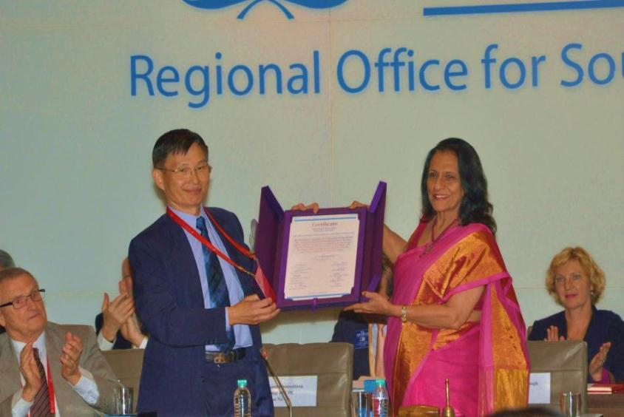
March 27, 2014:
South-East Asia Region of WHO certified polio-free

Slide 15
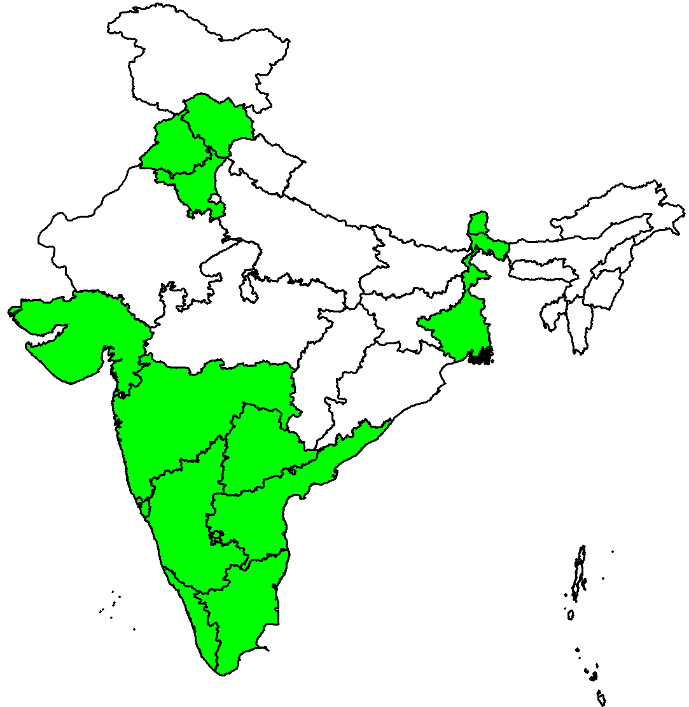
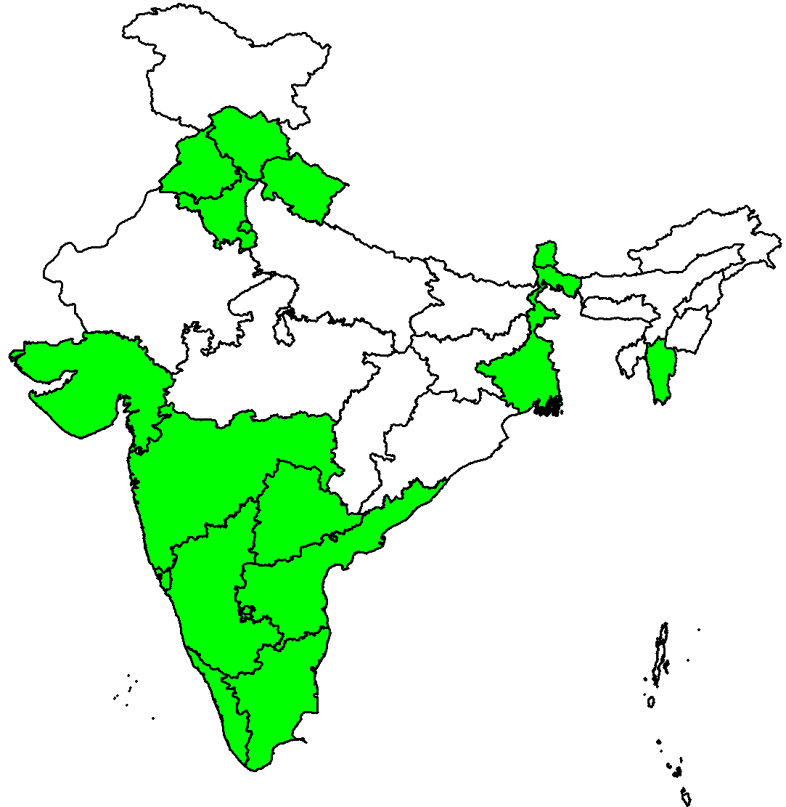
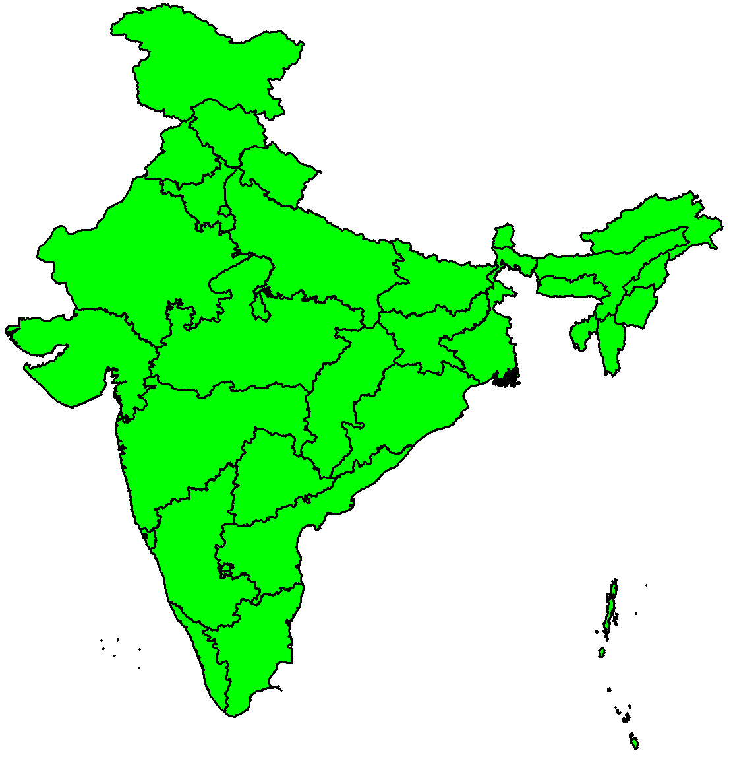
India validated Maternal and Neonatal Tetanus Elimination in 2015 A Major Milestone achieved
2003–2012
2013
2014
2015
15 May 2015:
“WHO congratulates India on achieving the milestone of MNTE”

Slide 16
Full Immunization coverage
Children are fully immunized when they have received one dose of BCG, 3 doses of DPT & Polio & a dose of Measles
NFHS: National family household survey; DLHS: District level household survey; CES: Coverage evaluation survey; RSOC: Rapid survey of children
Notes:
Overall increase in full immunization coverage
Full Immunization increased from 14 million children to 15 million, increase coverage of 1 million children since 2009;
Drop out From DPT2 to 3: around 10 %; OPV2 to 3: 9 points

Slide 17
Mission Indradhanush: A new beginning for RI in 2015!!

Slide 18
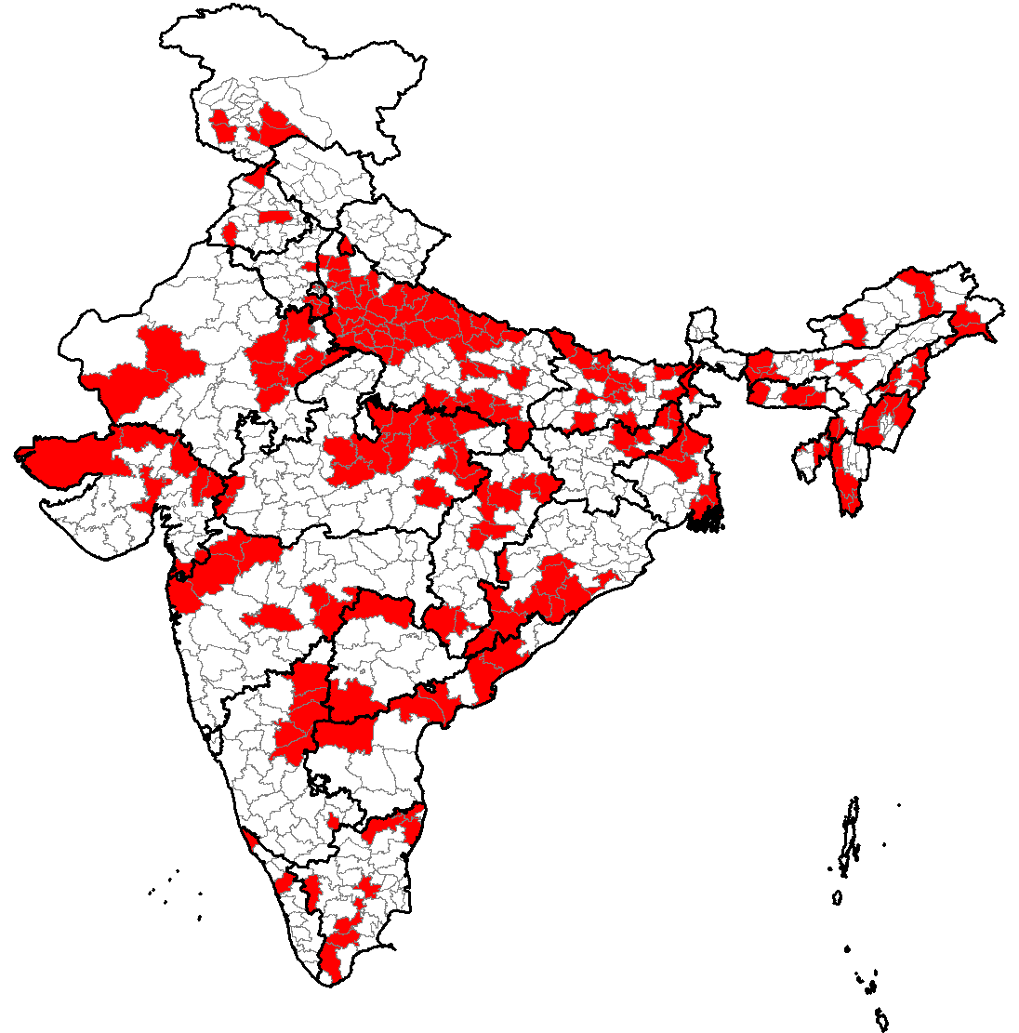
Mission Indradhanush (Rainbow): Reaching all children
Launched by MoHFW on 25 Dec 2014 as a special drive to strengthen routine immunization in the country
Focuses on interventions to ensure high coverage of children and pregnant women
Special attention to 201 high focus districts in Phase 1 including 6 in Karnataka with nearly 50% of all unvaccinated or partially vaccinated children
297 Medium Focus districts selected in Phase 2 including 12 in Karnataka
Karnataka State has chosen 6 more districts – Total 18 Districts in Karnataka
201 High focus districts in Phase 1
And 297 districts in Phase 2

Slide 19
Timelines for Mission Indradhanush: 2015 & 16
Mission Indradhanush Phase I
Mission Indradhanush Phase II
18 Jan
22 Feb
0
Jan
Feb
Mar
Apr
May
Jun
Jul
Aug
Sep
Oct
Nov
Dec
Jan
Mission Indradhanush
NID (tOPV)

Slide 20
Areas under focus - Mission Indradhanush
S1. Settled HRA identified during Polio Campaigns - Low Coverage Area – (Due to large population/ high workload)Small villages, hamlets, tandas, field huts etc. clubbed/tagged with another village for RI sessions and not having independent RI sessions
S2: Areas with vacant sub-centers and temporary vacant sub centres (areas with last three RI sessions not held: JHA(F) on long leave/ other reason)
S3. Areas with Measles outbreaks or cases of Diphtheria/ Neonatal Tetanus in last two years
Migrant population areas identified during Polio campaigns:
M-1 (Slum with Migration)
M-2 (Nomads)
M-3(Brick Kilns)
M-4 (Construction Sites)
M-5 (Others)

Slide 21
Strategy for Mission Indradhanush
4 intensified RI drives in 4 successive months:
Each drive will begin on 07th of the month and will last for up-to seven working days (based on the actual need).
Targeted beneficiaries:
Pregnant women and Children under two years of age who have missed Routine Immunization doses
Children above two years of age seeking vaccination services at any Indradhanush Vaccination Centre (IVC) will not be denied services
Routine immunization system strengthening:
Try to Include areas identified for Mission Indradhanush in regular RI plans
RI sessions on other days of the week other than Thursday to focus on areas identified for Indradhanush

Slide 22
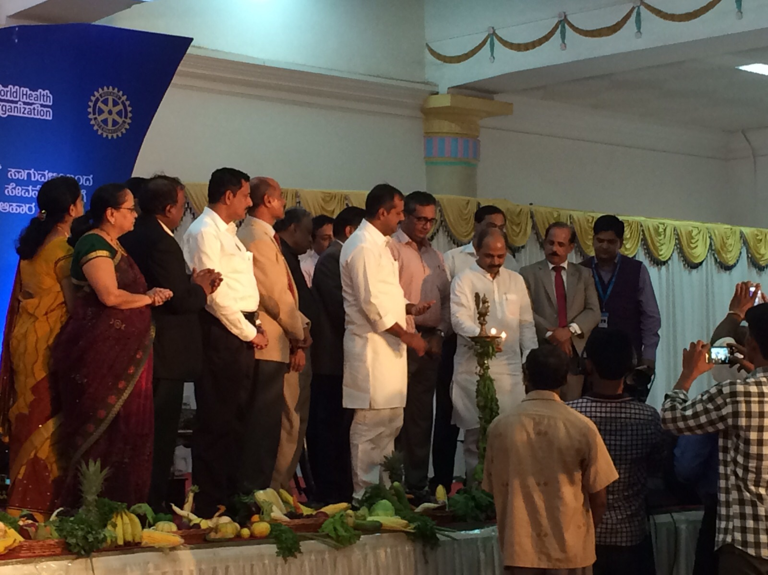
Mission Indradhanush was launched by Hon’ble Health Minister and Medical Education Minister on April 7th the World Health Day at the historic Vidhan Soudha Banquet hall - Karnataka

Slide 23
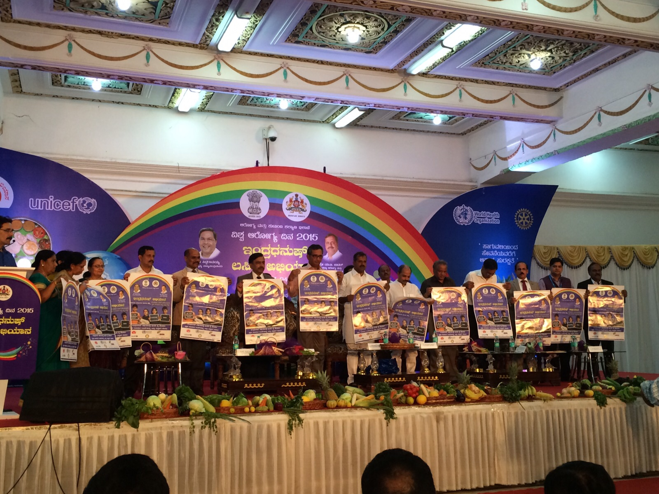
Release of Posters and other IEC material

Slide 24
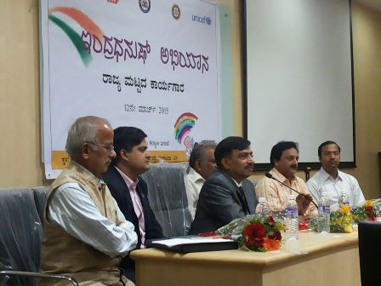
Principal Secretary and Commissioner lead from the front & motivated the team

Slide 25
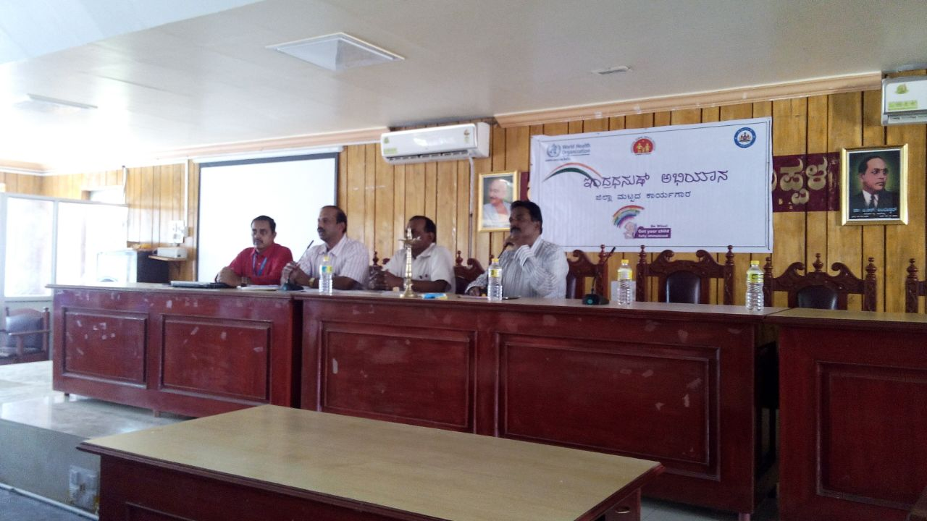
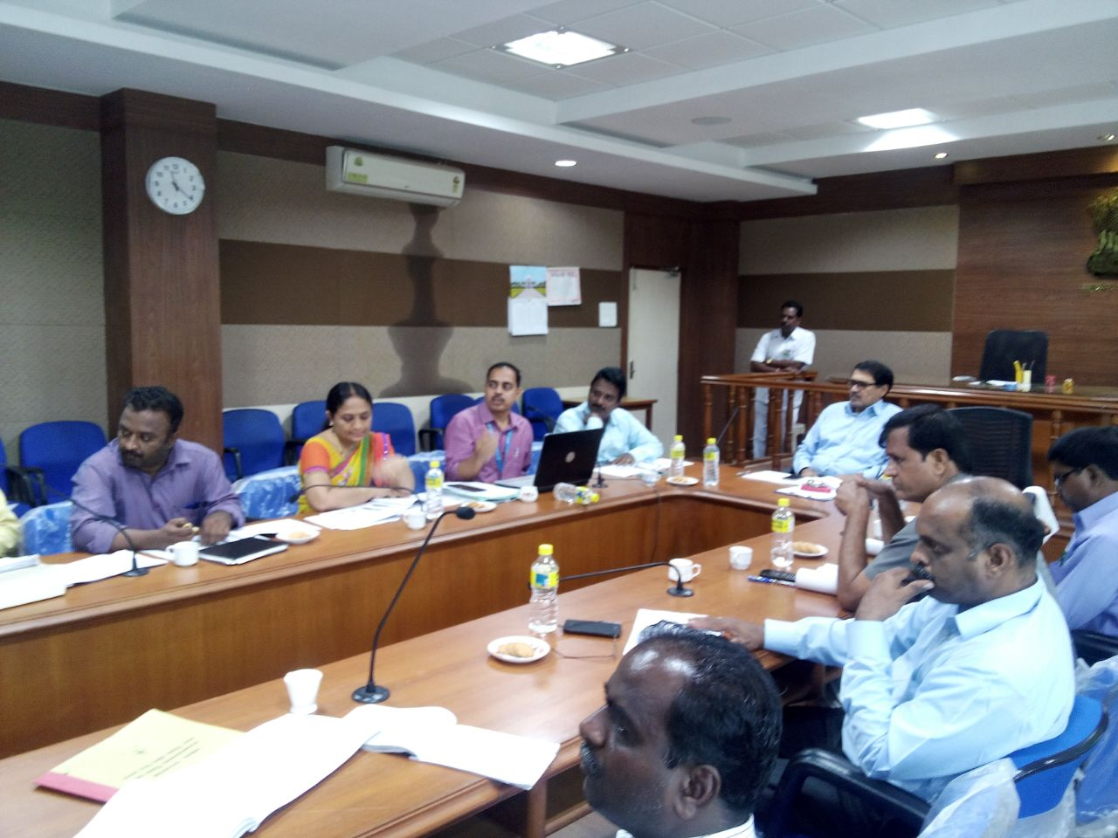
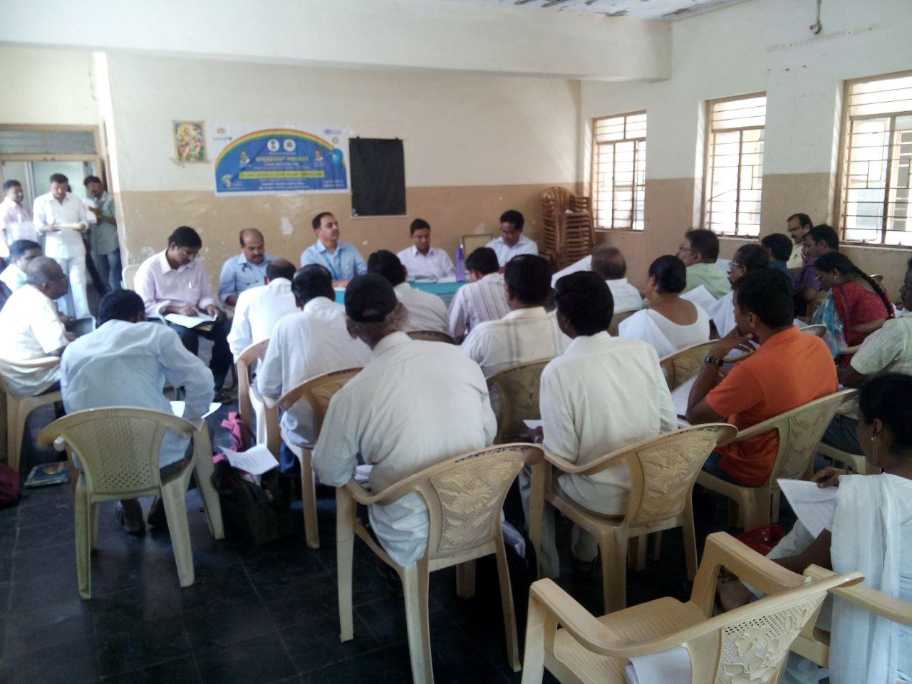
Strong ownership by District DCs, CEOs and Taluk level officials in all the districts

Slide 26
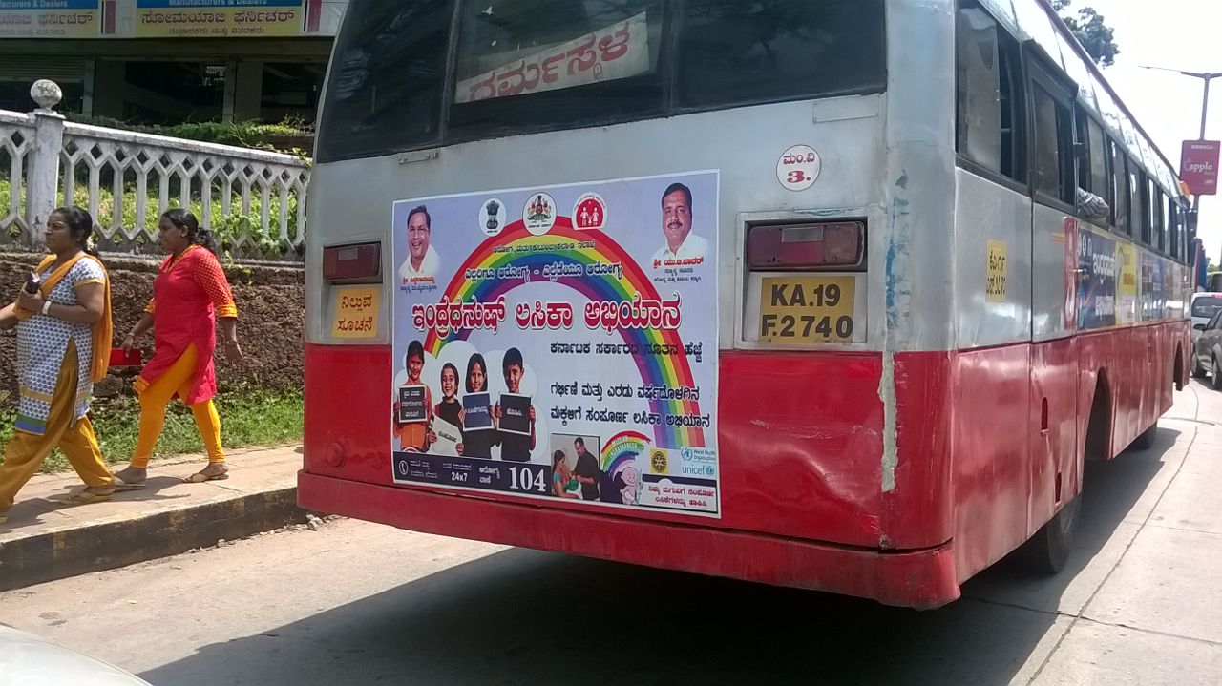
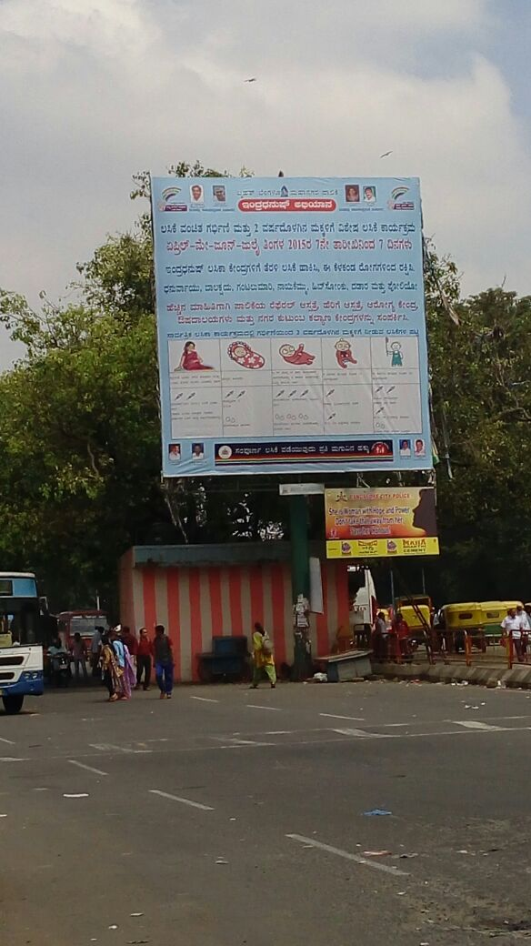
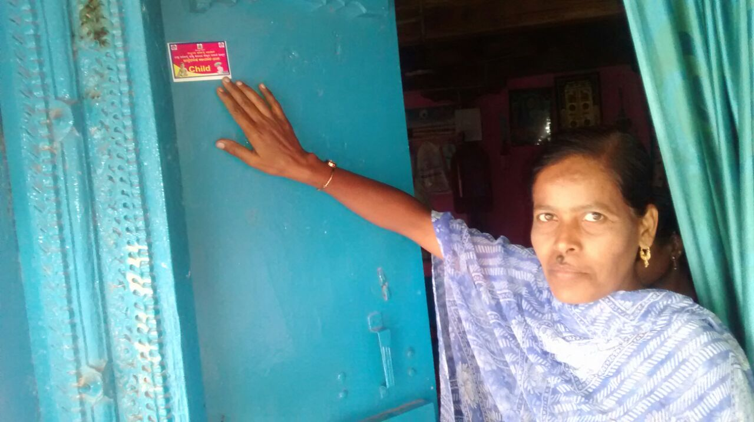
Extensive IEC efforts for MI

Slide 27
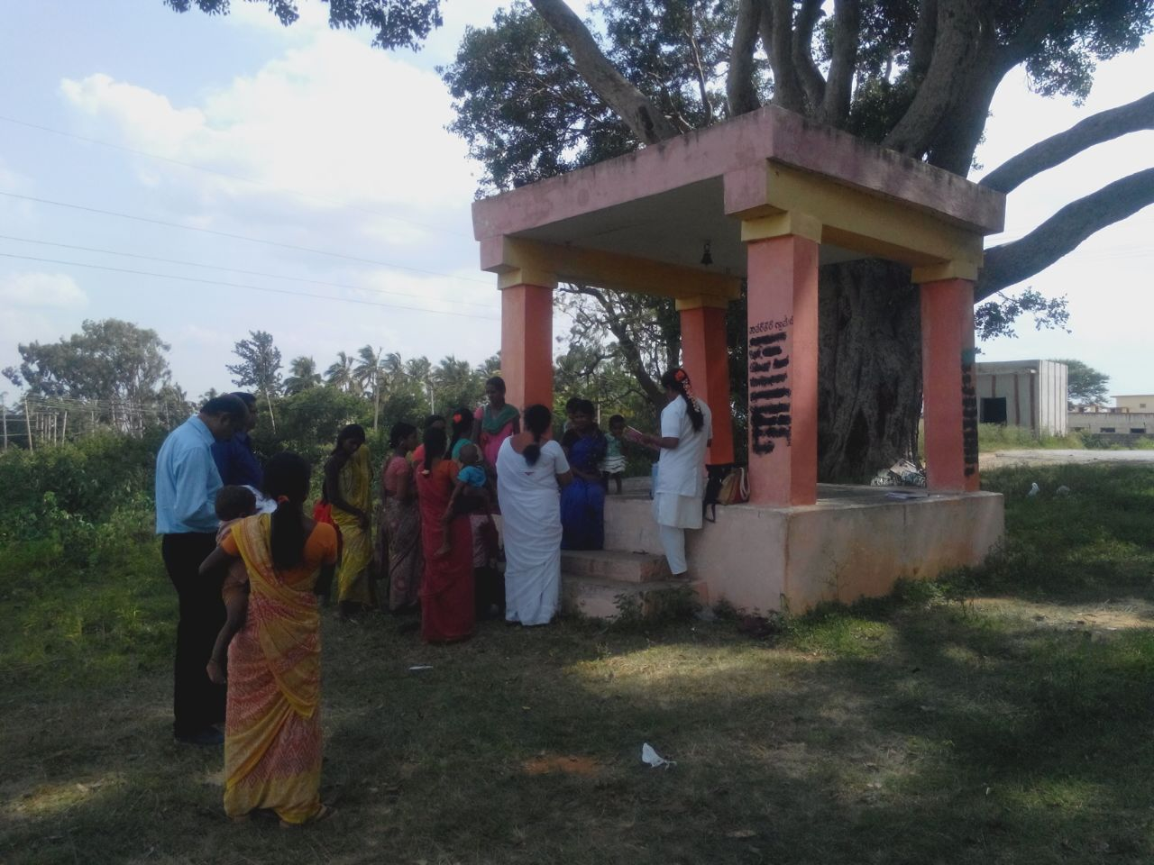
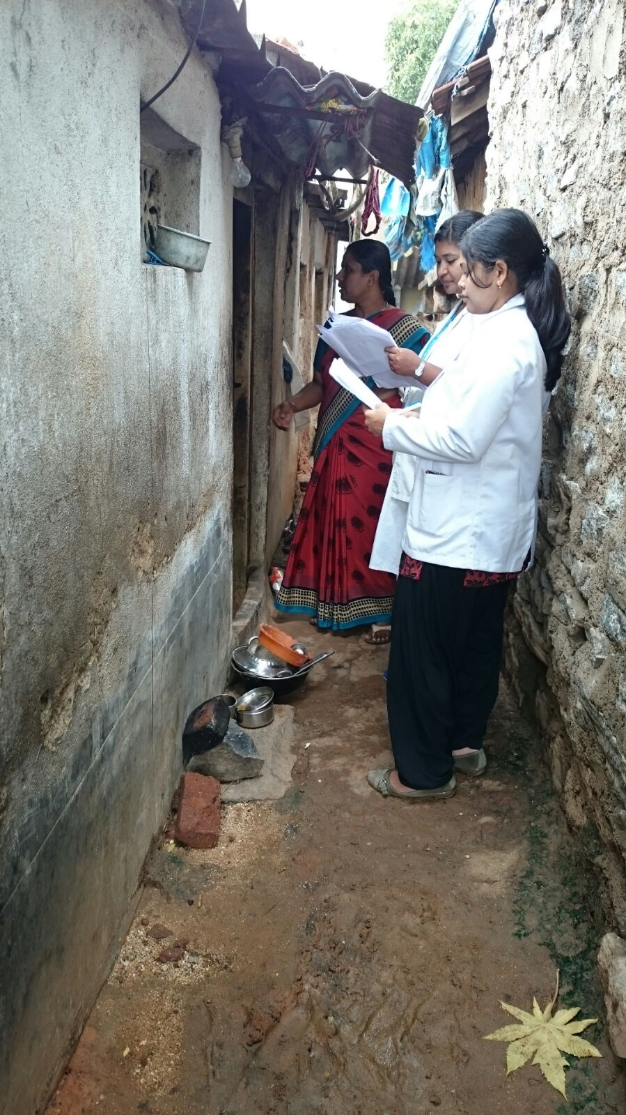
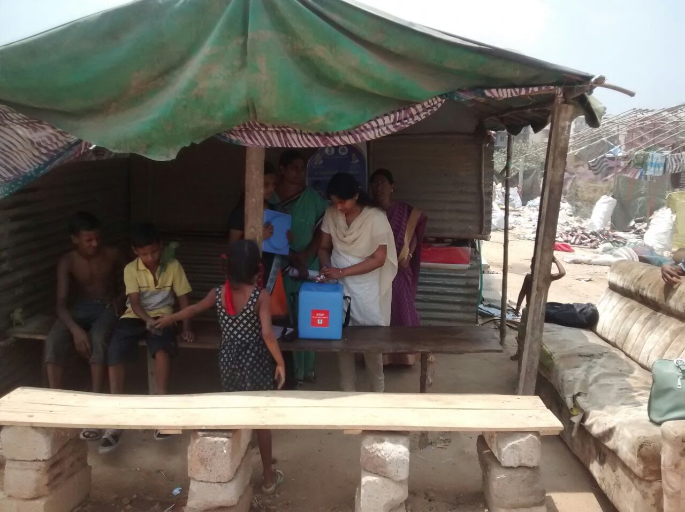
RI Sessions held beyond the PHC, Health Sub Centre and Anganwadi centres….close to the community
AND Intense monitoring of the MI campaign by GoI, State nodal officers, WHO NPSP officers and External monitors

Slide 28
The out come of Phase 1 April to July 2015
About 38,395 children fully immunized with first year’s doses of all vaccines
More than 33,300 children completed second year booster doses
About 5% children received vaccine for the first time in their life…..
Quality of sessions, parent’s awareness improved from round to round
The campaign extended for 3 more months from August to October in all the six districts at State’s own initiative.
10,000 more children have been Fully immunized (Total 48000 children immunized) till now in the six districts

Slide 29
Polio Endgame

Slide 30
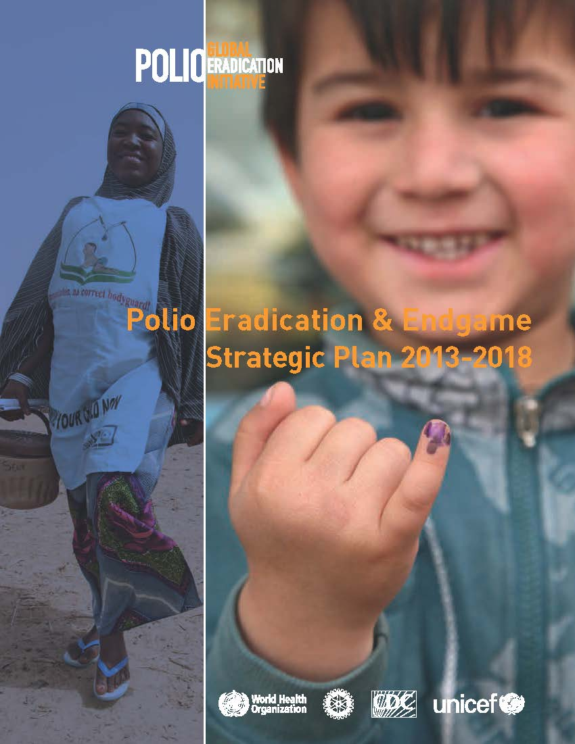
The Polio Eradication & Endgame Strategic Plan 2013-2018
Endgame Goal: complete the eradication, containment & certification of all wild & vaccine-related polioviruses.

Slide 31
Endgame Plan, 2013-18
Poliovirus detection & interruption
OPV withdrawal, IPV introduction, RI strengthening
Containment & Global Certification
Legacy Planning

Slide 32
Endgame Major
Objectives
Last wild polio case
Last OPV2 use
Certification
2013 2014 2015 2016 2017 2018
Virus detection & interruption
Wild virus
interruption
Outbreak response
(esp. cVDPVs)
RI strengthening & OPV withdrawal
RI strengthening &
OPV2 pre-requisites
Introduce IPV
OPV
withdrawal
Containment & certification
Finalize long-term containment plans
Complete containment
& certification globally
Legacy Planning
Consultation & strategic plan
Initiate implementation of legacy plan

Slide 33
Why is the Polio endgame needed?
To secure the polio eradication forever, all live polioviruses must be removed from populations, including all vaccine viruses.
Without achieving this, polio eradication is not possible.

Slide 34
Paralysis associated with use of OPV
VAPP (Vaccine Associated Paralytic Poliomyelitis): Vaccine virus acquires neurovirulence and causes paralysis in vaccine recipient or close contact
VDPVs (Vaccine Derived Polio Viruses): Vaccine virus acquires the virulence and transmissibility characteristics of wild virus following prolonged multiplication in the gut or community
Types of VDPVs:
circulating VDPVs (cVDPVs)
immunodeficient VDPVs (iVDPVs)
ambiguous VDPVs (aVDPVs)

Slide 35
Rationale for OPV2 withdrawal
Risks of OPV2 now outweigh the benefits
Last naturally occurring case of WPV case detected in Aligarh, India in 1999 – WPV 2 ERADICATION CERTIFIED I
Type 2 polio vaccine causes >95% of Vaccine Derived Polio Virus (VDPV) cases
Type 2 causes approximately 40% of Vaccine-associated paralytic poliomyelitis (VAPP) cases
Type 2 component of OPV interferes with immune response to types 1 and types 3

Slide 36
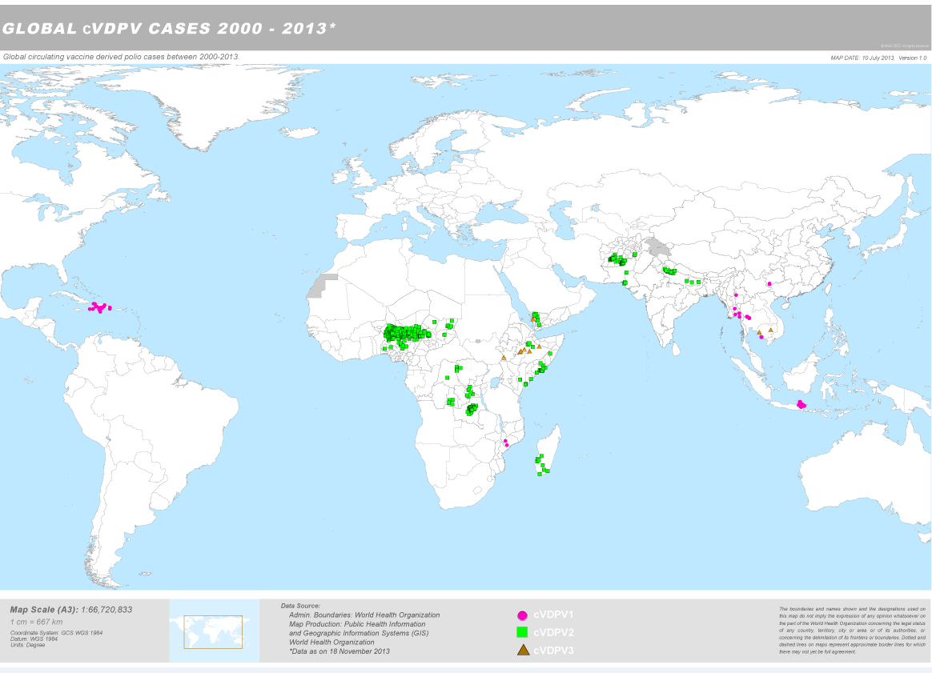

Slide 37
Withdrawal of Oral Polio Vaccines
Globally synchronized, phased withdrawal of OPV strains, starting with OPV type 2
OPV type 2 withdrawal means that tOPV (P1+P2+P3) must be replaced with bOPV (P1+P3)
Withdrawal of OPV type 2 will reduce risk of emergence of cVDPV type 2 and also reduce the burden of VAPP cases due to OPV type 2

Slide 38
Mitigate the risk of low population immunity against type 2 polio
Introduce IPV prior to OPV type 2 withdrawal

Slide 39
How does IPV help?
Single dose of IPV, given to children previously vaccinated with OPV, boosts humoral and mucosal immunity significantly
Single dose of IPV given to children that have not received OPV doses previously seroconverts 63% children and primes 99% children

Slide 40
How does IPV help?
Will IPV provide good humoral immunity
Will IPV increase humoral immunity in OPV primed children?
Will IPV increase mucosal immunity?
Will IPV help in reducing VAPP?
What is the best age to give IPV?
How many IPV doses are needed?

Slide 41
Single IPV dose closes humoral immunity gaps in OPV-vaccinated infants
(Côte d'Ivoire, 1990-91)
Percent seropositive
Impact of IPV vs. OPV booster in OPV vaccinated sero-negative children 9 months of age
N=346

Slide 42
Study in India confirms a single IPV dose closes humoral immunity gap in OPV primed children (Moradabad, 2009)
Percent seropositive
Age: 6-9 months
OPV primed children
Single dose of IPV given at day 0 of study
Blood collected at baseline & 28 days
N= 862

Slide 43
Single IPV boosts mucosal immunity in children with multiple OPV doses (Moradabad, 2011)
40
50%
30
IPV reduced fecal excretion for poliovirus types 1 and 3 between 38.9-74.2% and 52.8-75.7%, respectively, compared to control
75%
P1 excretion after day 28 challenge (%)
20
10
After challenge with vaccine viruses, the reduction in fecal excretion was also greater in children who received an additional dose of IPV prior to challenge, than children who received an additional dose of bOPV
0
bOPV
IPV
bOPV
IPV
bOPV
IPV
No Vaccine
No Vaccine
No Vaccine
Day 31
Day 35
Day 42
6-11 months
5-6 yrs
10-11 yrs
N=990
*Hamid Jafari et al. Efficacy of inactivated poliovirus vaccine in India. Science 345, 922 (2014);

Slide 44
STUDY
FINDINGS
A dose of IPV given to children aged 1–4 years previously vaccinated with OPV substantially increased humoral and intestinal mucosal immunity to poliovirus
Serum neutralizing antibodies were substantially increased and these children were signiﬁcantly less likely to shed poliovirus after challenge with bOPV
*http://dx.doi.org/10.1016/S0140-6736(14)60934-X
Notes:
Add hyperlink to the back-up graphics on the back up

Slide 45
Early versus later IPV administration
Seroconversion for type 2 after a dose of IPV – studies from different countries
Author | Year | Country | Number of Subjects | Schedule | % Seroconversion for Type 2
McBean | 1988 | US | 309 | 2 Month | 35%
Simasathein | 1994 | Thailand | 103 | 2 Month | 39%
Resik | 2010 | Cuba | 177 | 6 Weeks | 36%
Mohammed | 2010 | Oman | 186 | 2 Month | 32%
Resik | 2013 | Cuba | 153 | 4 Month | 63%
4 month IPV dose: 63% seroconversion; 99% seroconversion & priming
Earlier administration (potential losses): seroconversion decreased (32-39% vs 63%); priming also lower (<90%)
Later administration: (potential gains): ? Seroconversion (>63%);
? Priming (> 98%)

Slide 46
Single dose IPV introduction in routine schedule eliminated VAPP in Hungary (Data:1961-2011)
In 1992,
single-dose
IPV at 3 months
VAPP number
In 2006,
IPV-only
schedule
Year

Slide 47
The approach
Emphasis on routine immunization strengthening
raising coverage critical for achieving the endgame
IPV to be introduced into the routine program
Switch from tOPV to bOPV

Slide 48
Recommended IPV Schedule*
At least one dose of IPV at 14 weeks or first contact afterwards
All children who are behind on their schedule should receive at least one dose of the IPV at the first immunization contact after 14 weeks of age
IPV does not replace ANY of the OPV doses
Until polio transmission is interrupted globally, OPV will be a critical component of the eradication strategy
WER, 3 Jan 2014, vol. 89, 1 (pp 1-20): at http://www.who.int/wer/2014/wer8901/en/index.html
Notes:
Rationale: a major risk factor for IPV failure is persisting maternal antibodies
Delaying to DTP3 gives time for maternal antibodies to wane allowing a better immune response to IPV
Giving IPV at DTP3 would induce high levels of seroconversion and protection among very young children
Delaying the dose to older ages would allow more time for children to be susceptible

Slide 49
National Immunization Schedule
Age | Vaccines given
Birth | BCG, OPV, Hepatitis B
6 Weeks | Pentavalent-1/DPT1+Hep-B1, OPV1
10 weeks | Pentavalent-2/DPT2+Hep-B2, OPV2
14 weeks | Pentavalent-3/DPT3+Hep-B3,OPV3, IPV
9-12 months | Measles (MCV1), JE**
16-24 months | Measles (MCV2), JE**, DPT booster-1, OPV
5-6 years | DPT booster 2
10 years | TT
16 years | TT
Pregnant Mother | TT1, 2 or TT Booster***
*Pentavalent (DPT+HepB+Hib)- currently in 20 states, to be rolled out in 16 states by Sep/Oct 2015
** in endemic districts only
*** one dose if previously vaccinated within 3 years

Slide 50
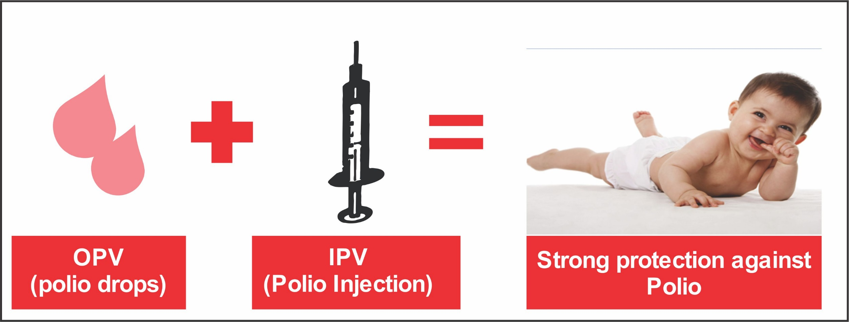
Combined use of IPV and OPV provides strong intestinal immunity and antibody protection against all three serotypes

Slide 51
Summary – Polio End Game
Globally coordinated withdrawal of OPV type 2 essential to eliminate VDPV and VAPP risks associated with continued use of OPV type 2
Withdrawal of type 2 OPV implies switching from tOPV to bOPV in the programme
Single dose of IPV will helps boost both humoral and mucosal immunity in children that have received OPV doses
Single dose of IPV at 14 weeks or the first contact thereafter is preferred option
Routine Immunization needs to be strengthened and AFP surveillance should remain highly sensitive

Slide 52
Thank you

